Slide 1
Introduction to Operating System [OSY-22516]
By : Shri A. D. Ambure
Lecturer in Computer Engg.
Government Residential Women’s Polytechnic Latur, Maharashtra.

Slide 2
OSY : MSBTE ‘I’ Scheme
Exam Duration : 3 Hours
Max Marks : 70(TH)+30(PA-TH)=100 Marks
Practical ESE : 25@(Internal Assessment)
Practical PA : 25 Marks
Total Contribution of OSY to Your 5th Sem. Percentage : 150/900 (16% approx)

Slide 3
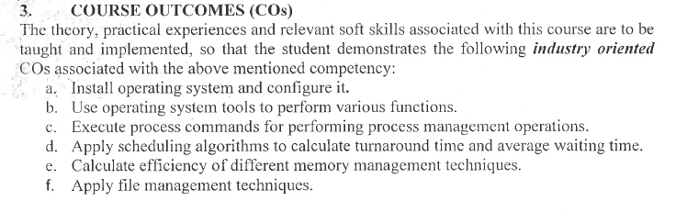
OSY : Course Outcomes (COs)

Slide 4
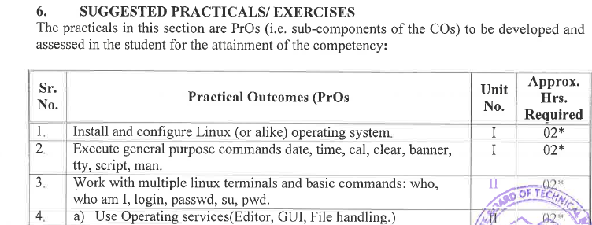
List of Experiments

Slide 5
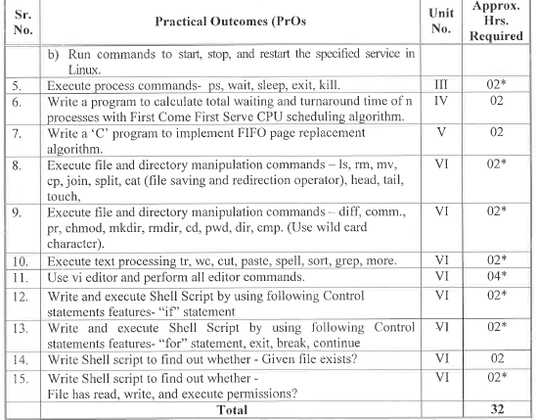

Slide 6
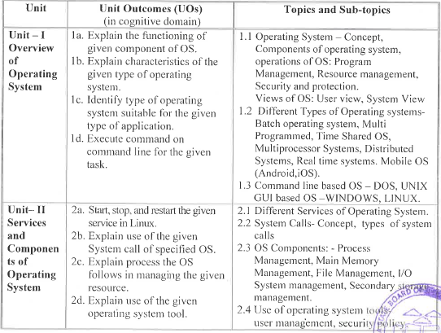

Slide 7
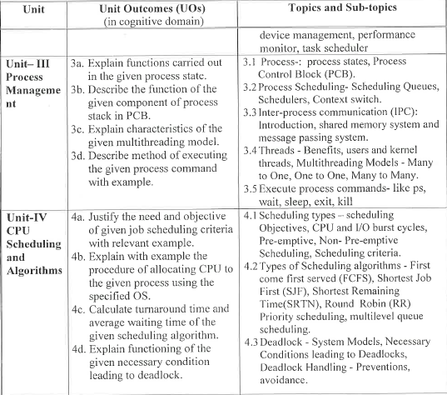

Slide 8
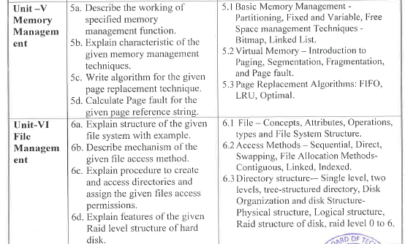

Slide 9
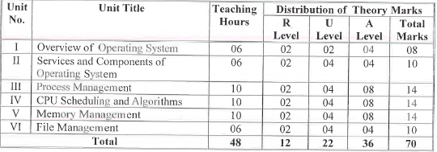
Question Paper design

Slide 10
